Slide 1

Random Matrix Theory model for DMR Beamformer Notch Depth
Sai Kasyap Kamaraju
G00845717
ECE 738 Final Presentation
Instructor :
Professor Kathleen Wage

Slide 2
Flow of Presentation
Defining the goal
Terminology
ND performance of DMR
Random Matrix Theory
Random Matrix Theory predications for DMR
RMT model ..
Conclusion
References

Slide 3
Goal..
To characterize DMR ABF’s ability to attenuate a single interferer as a function of number of array elements (N), number of snapshots (L), Interferer power (INR) and interferer location(ui) w.r.t look direction(Broad side).
Assumptions :
N = 50 , ui = 3/N =0.06

Slide 4
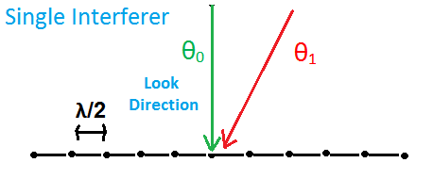
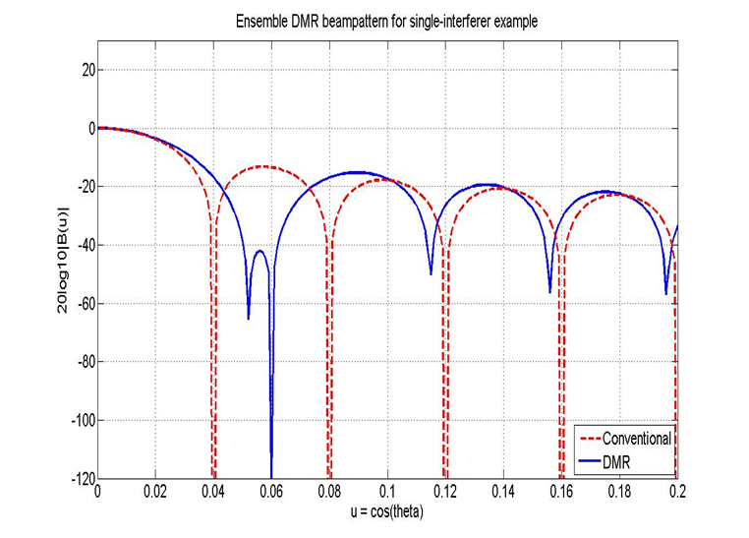
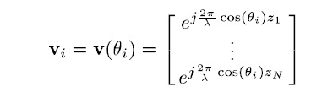

Narrow Band Beamforming Model
Observing Signals on an N element array
n: spatially white noise (complex Gaussian, mean = 0, variance =
Array Weights W
Array output = w^{H}x
Beampattern : │w^{H}v│²
Notchdepth = ND = │w^{H}v_{i}│², v_{i} replica vector of the interferer.

Slide 5




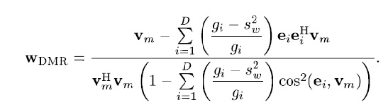

Dominant Mode Rejection Beamformer
DMR [Abraham & Owsley, Proc. Oceans, 1990]
Large Eigen values are assumed as interferers
Small Eigen values are averaged.
For Ensemble case :
Forming SCM :

Slide 6
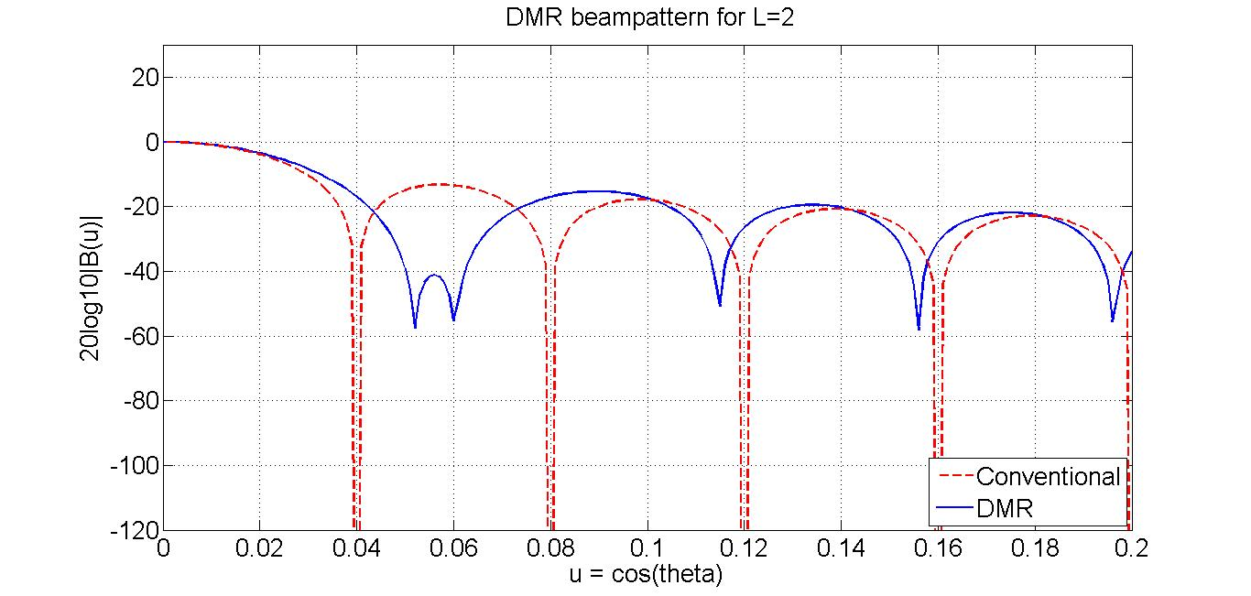
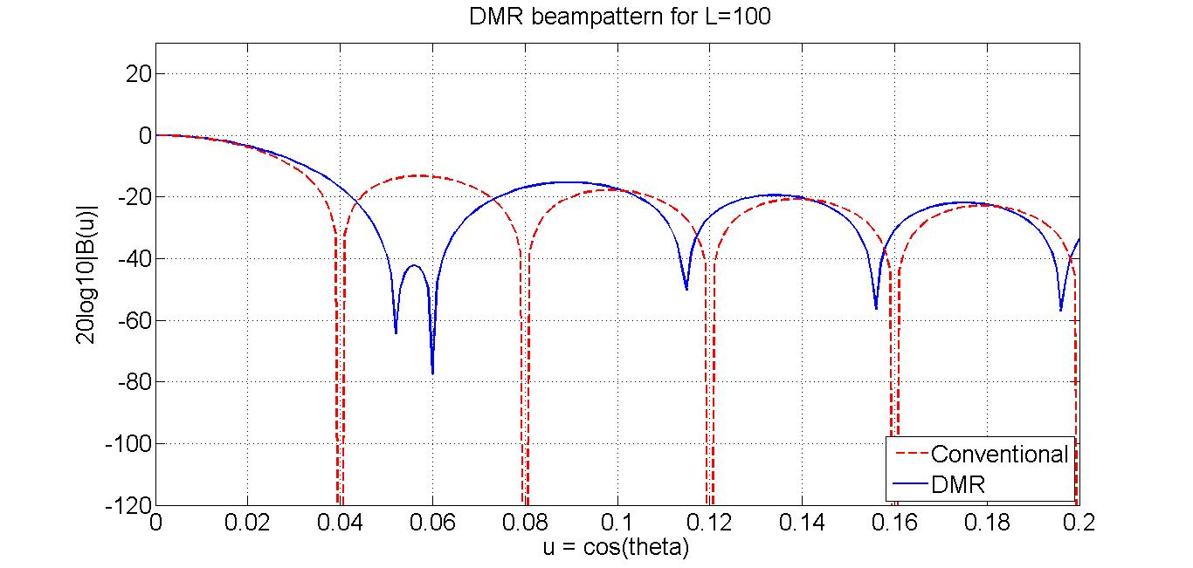
Notch depth of DMR as function of number of snapshots

Slide 7


Eigen Vectors Vs Eigen Values

Slide 8
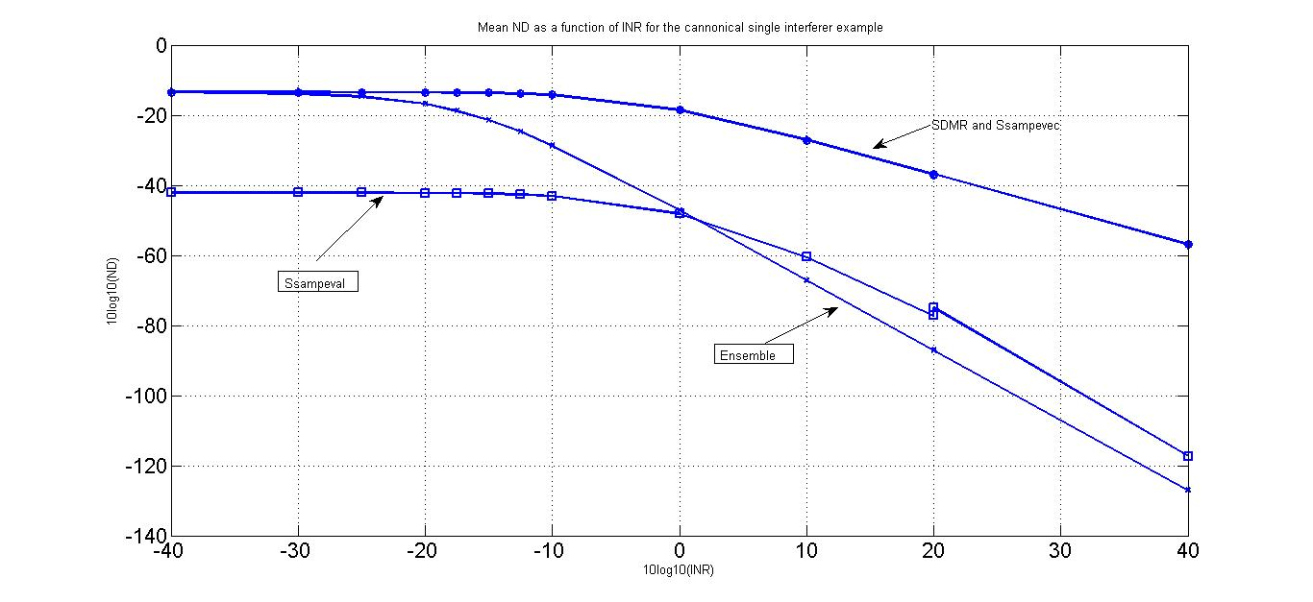
Eigen Vectors vs Eigen Values

Slide 9
RANDOM MATRIX THEORY
As we know, the sample eigenvectors have a
greater impact on DMR performance than the sample eigenvalues
The Aspect Ratio c = N/L is kept constant.
The values of N,L → Infinite

Slide 10
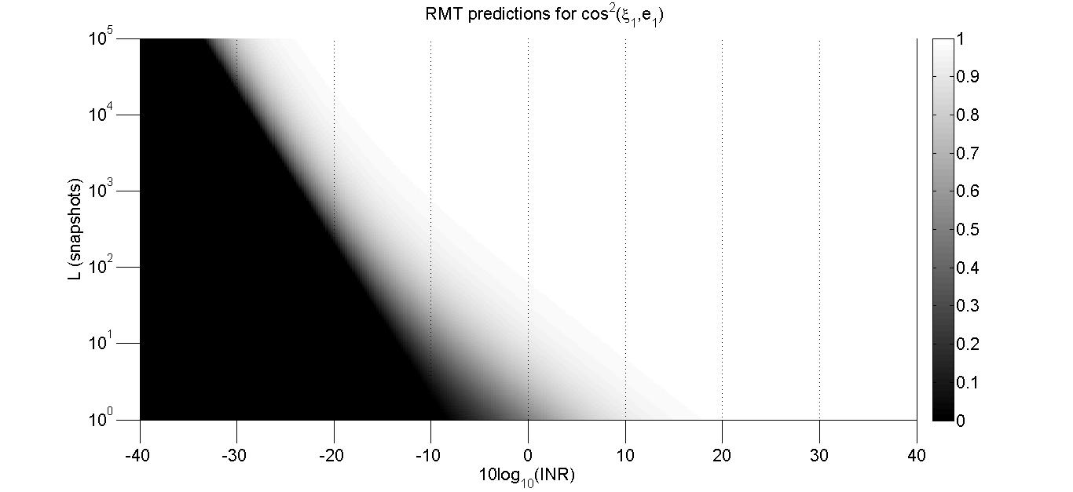
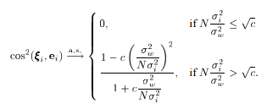
RMT Approach

Slide 11


RMT model Derivation requisites
Now apply RMT results on the Eigen vectors above to get the ND results

Slide 12
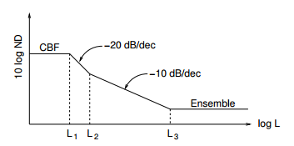

Notchdepth vs Snapshots
Break points

Slide 13
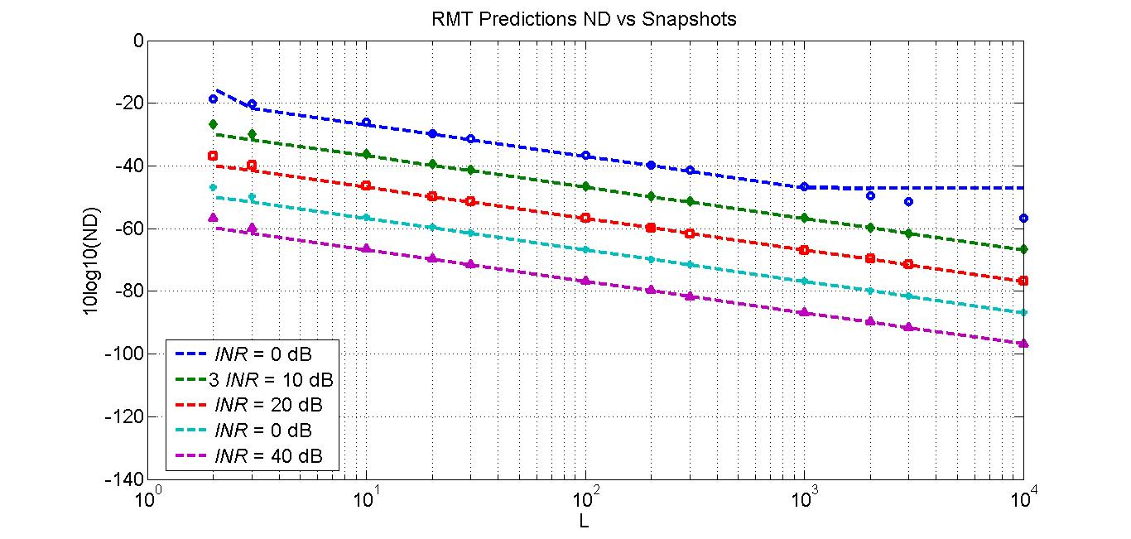
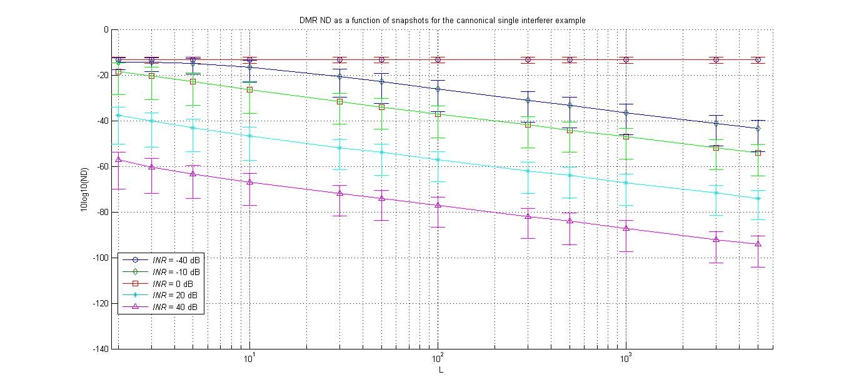
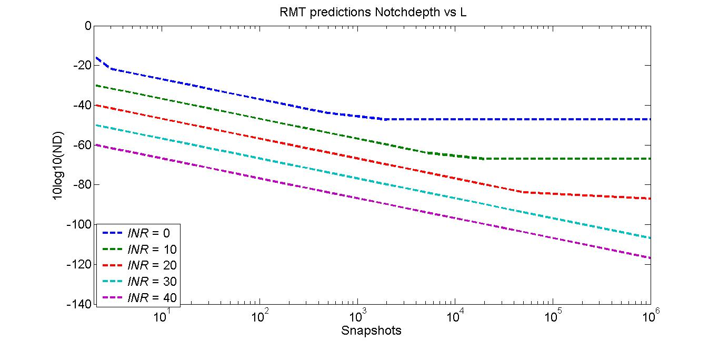
Comparison of Monte Carlo simulations and RMT values ND vs Snapshots

Slide 14
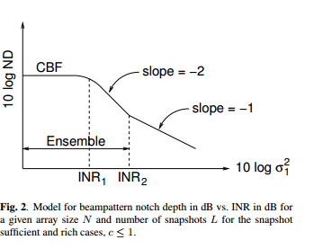
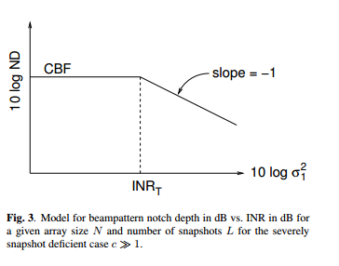
Notch depth vs INR

Slide 15
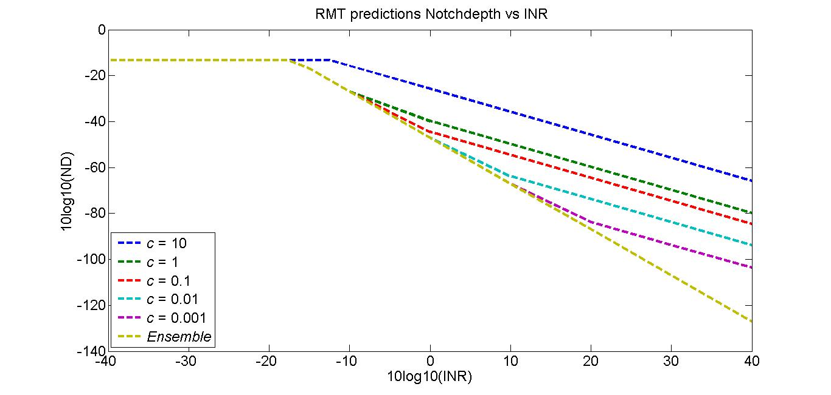
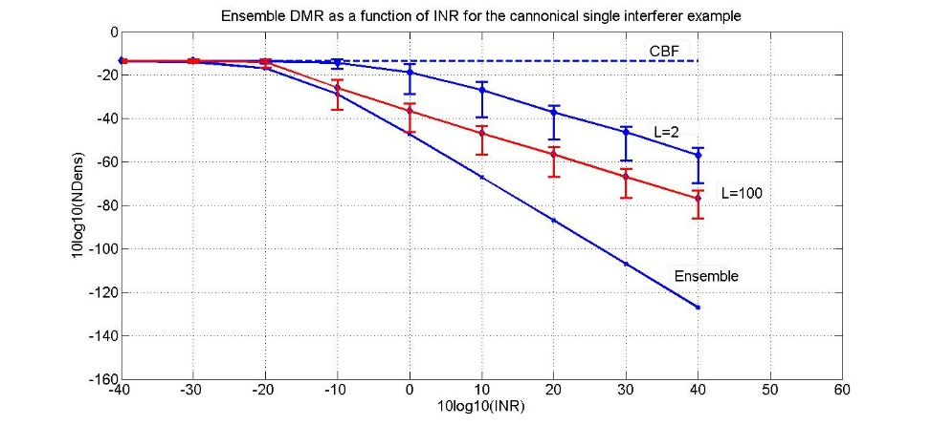
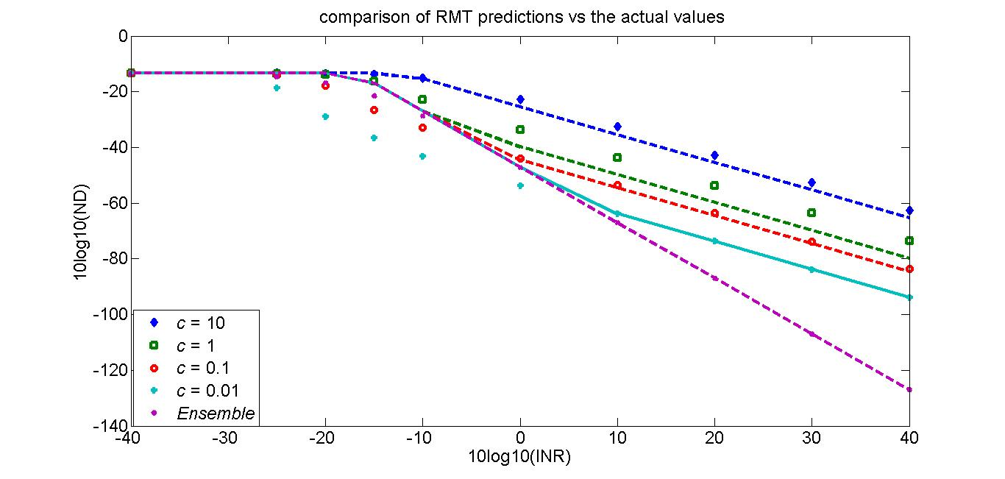
Comparison of RMT Predictions and Monte Carlo simulations ND vs INR

Slide 16
Conclusions
Bode plot style of hand sketching accurately predict the DMR beamformer to attenuate loud interferer signal
Notch depth increases by 10 dB per decade as we go on the operating range of snapshots
DMR does not benefit after increasing INR beyond INR2 threshold..

Slide 17
References
A Random Matrix Theory model for DMR Notchdepth by prof Kathleen and John R.Buck.
Snapshot perfomance of dmr beamformer by
by Prof Kathleen and John R.Buck

Slide 18
Thank you

